Slide 1


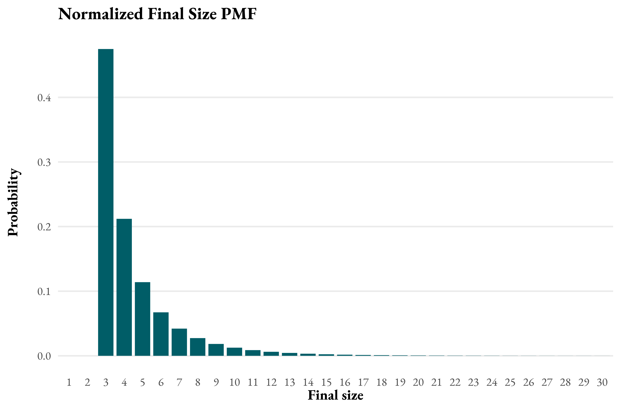
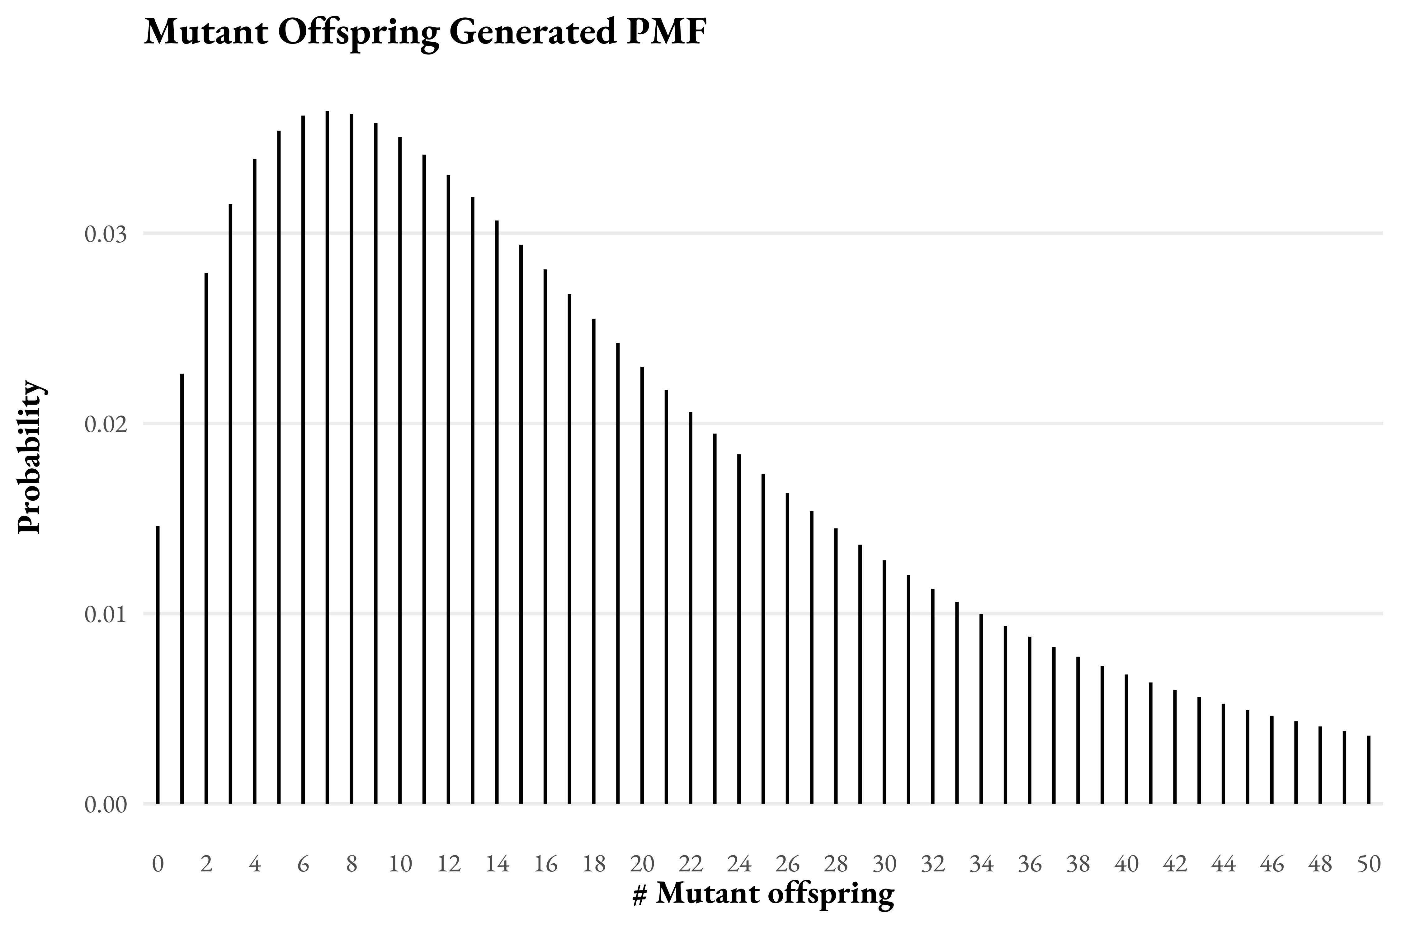
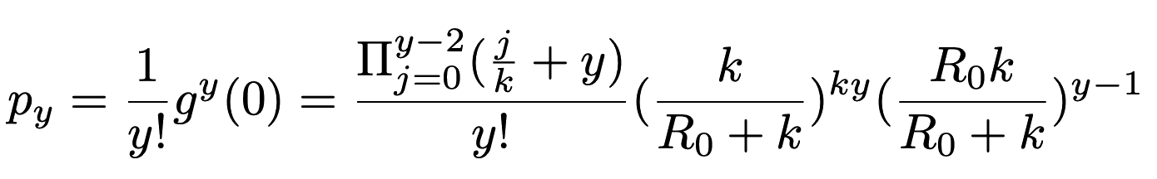
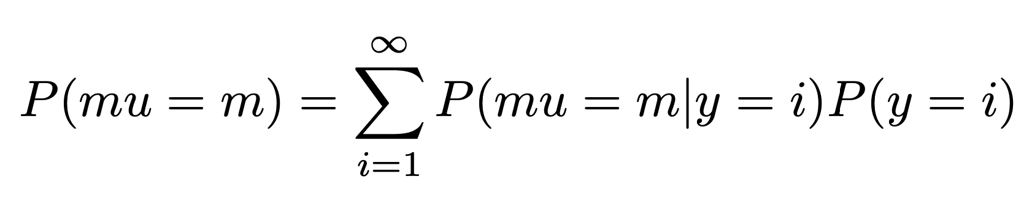
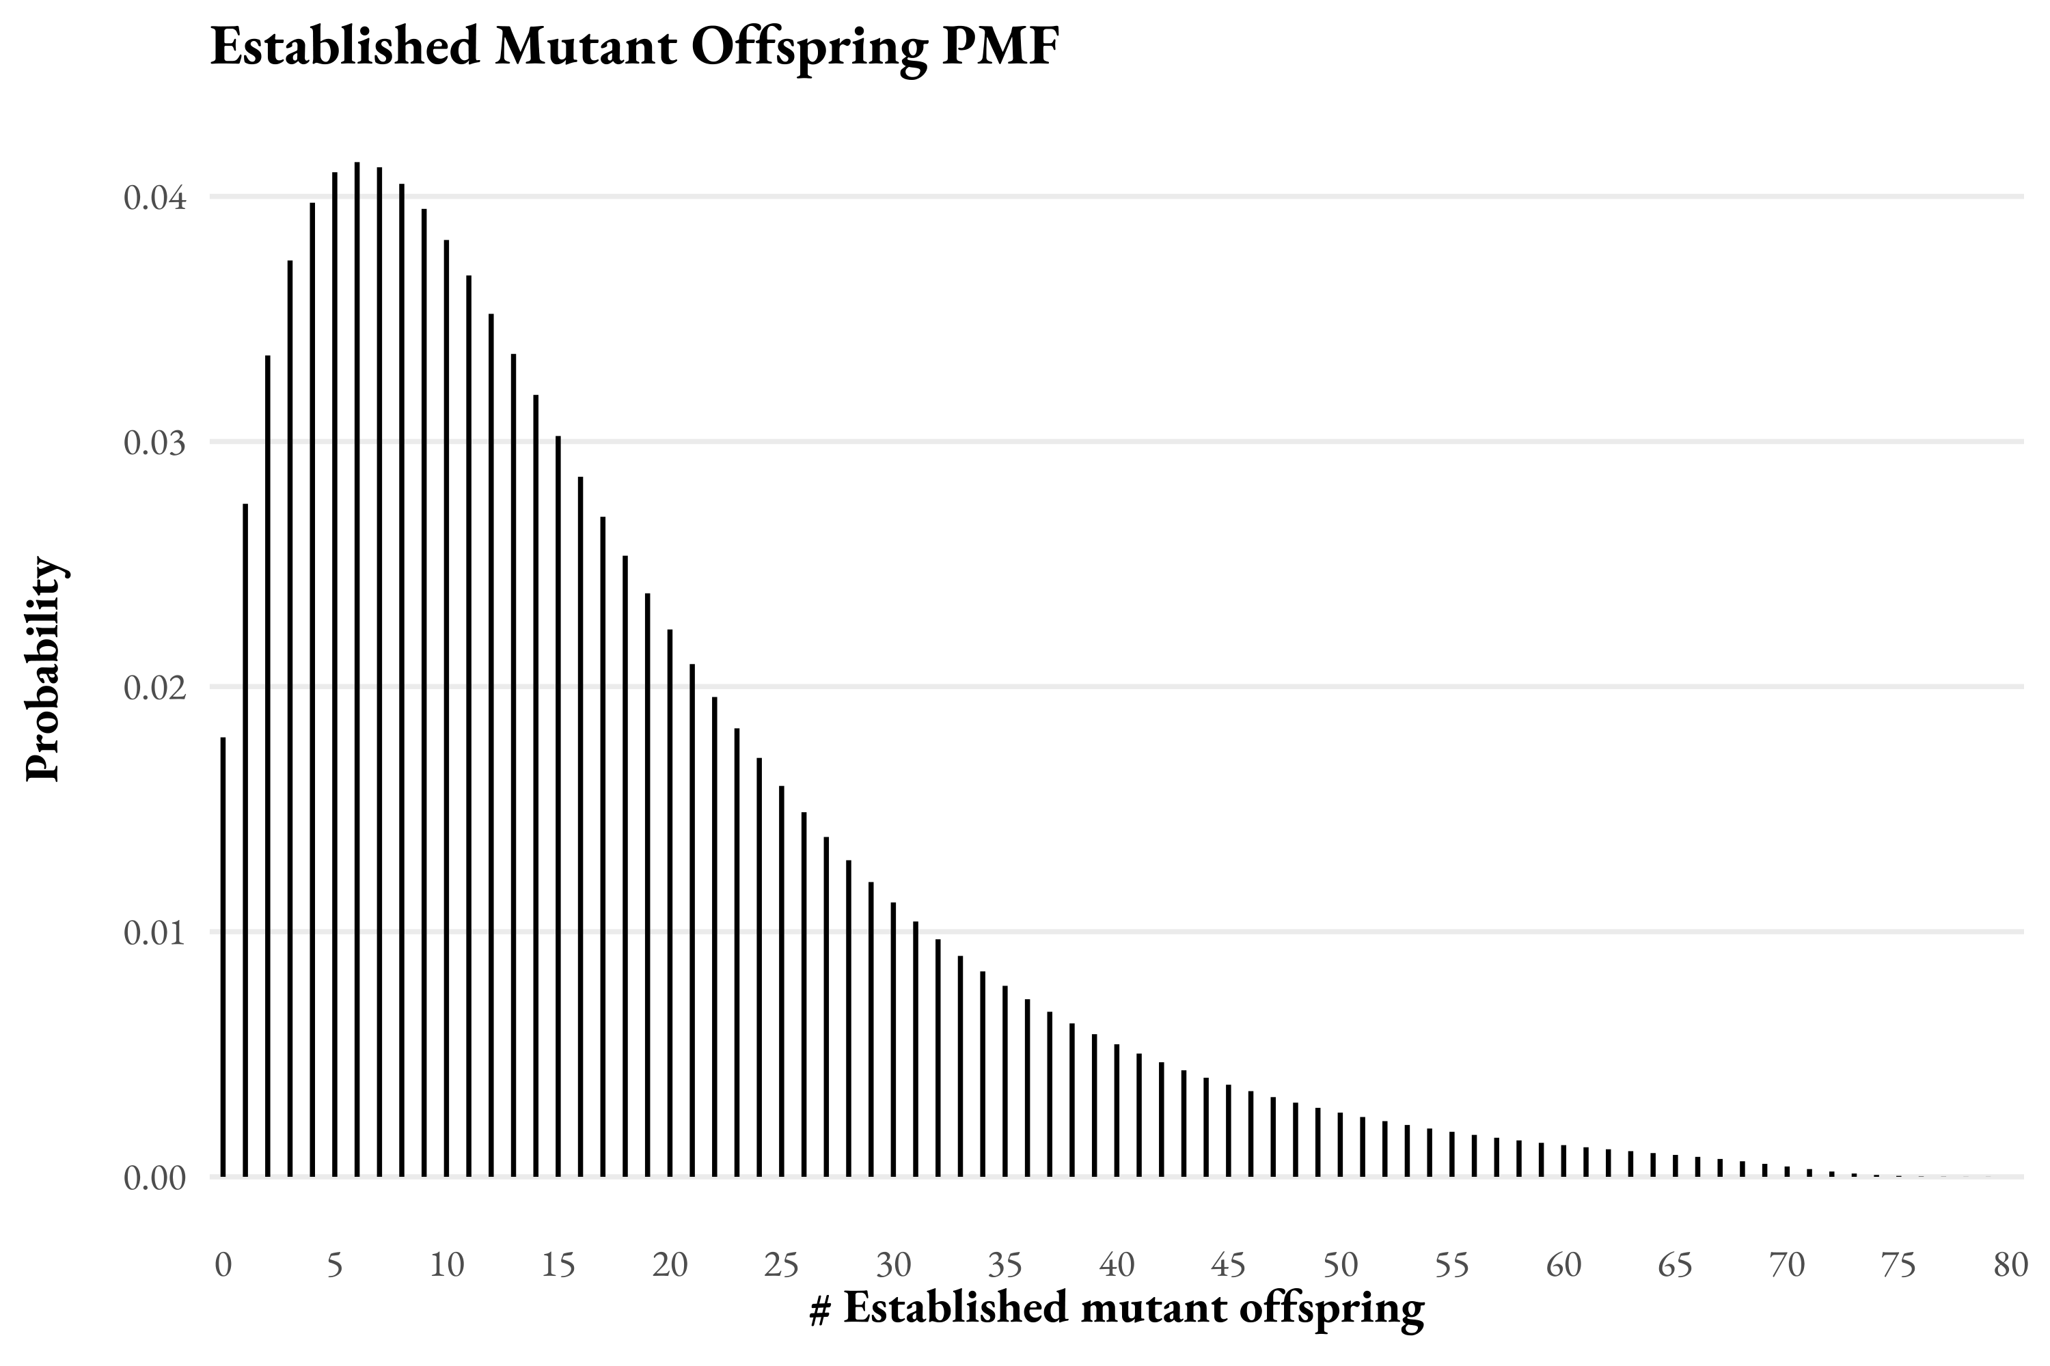
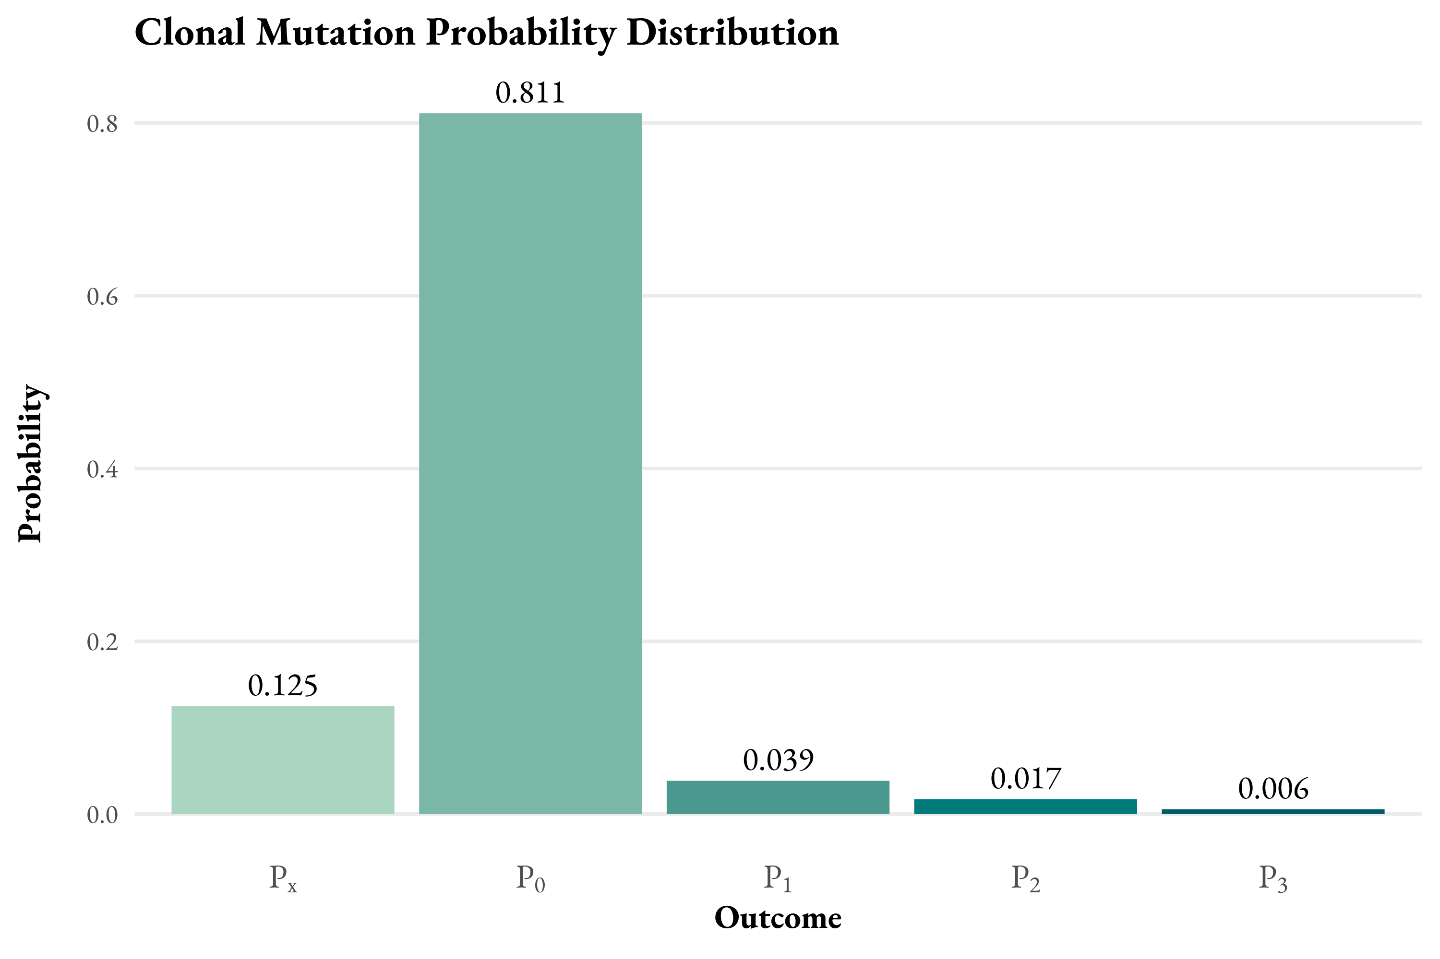
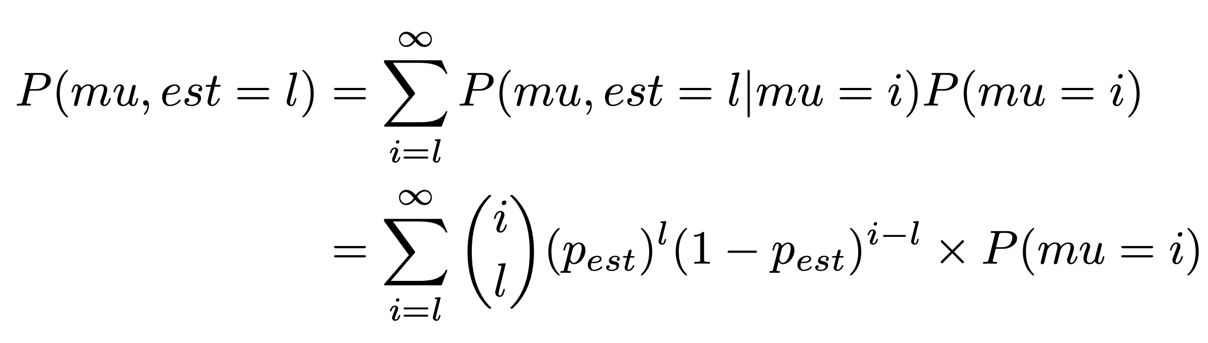
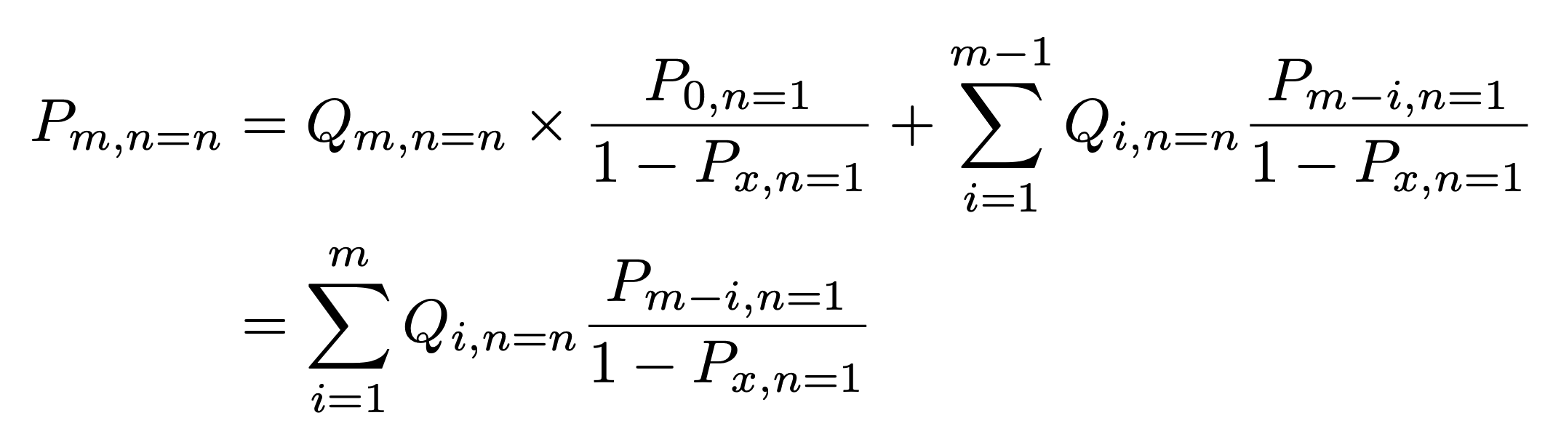
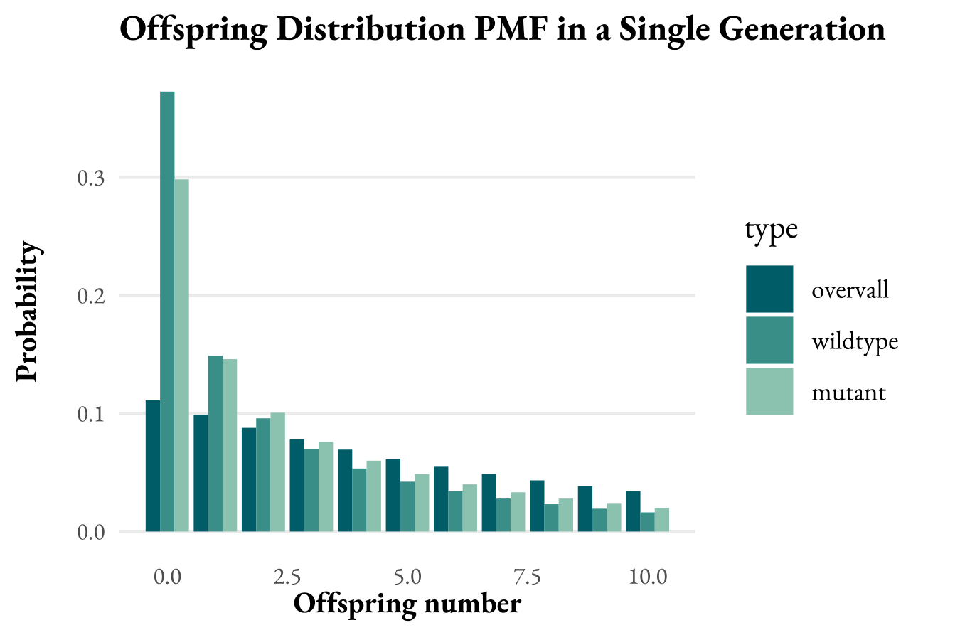
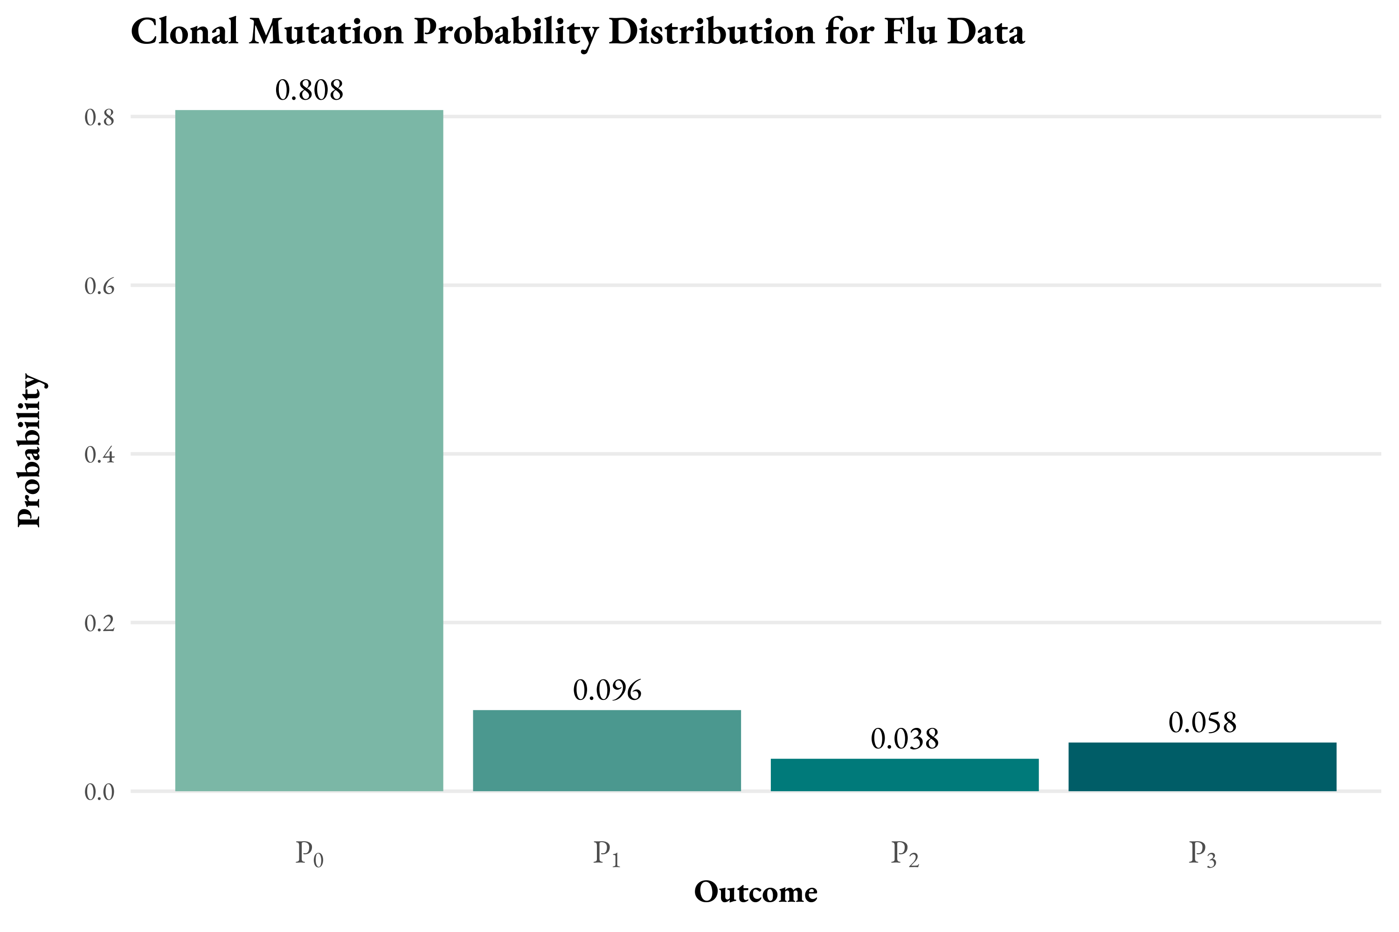
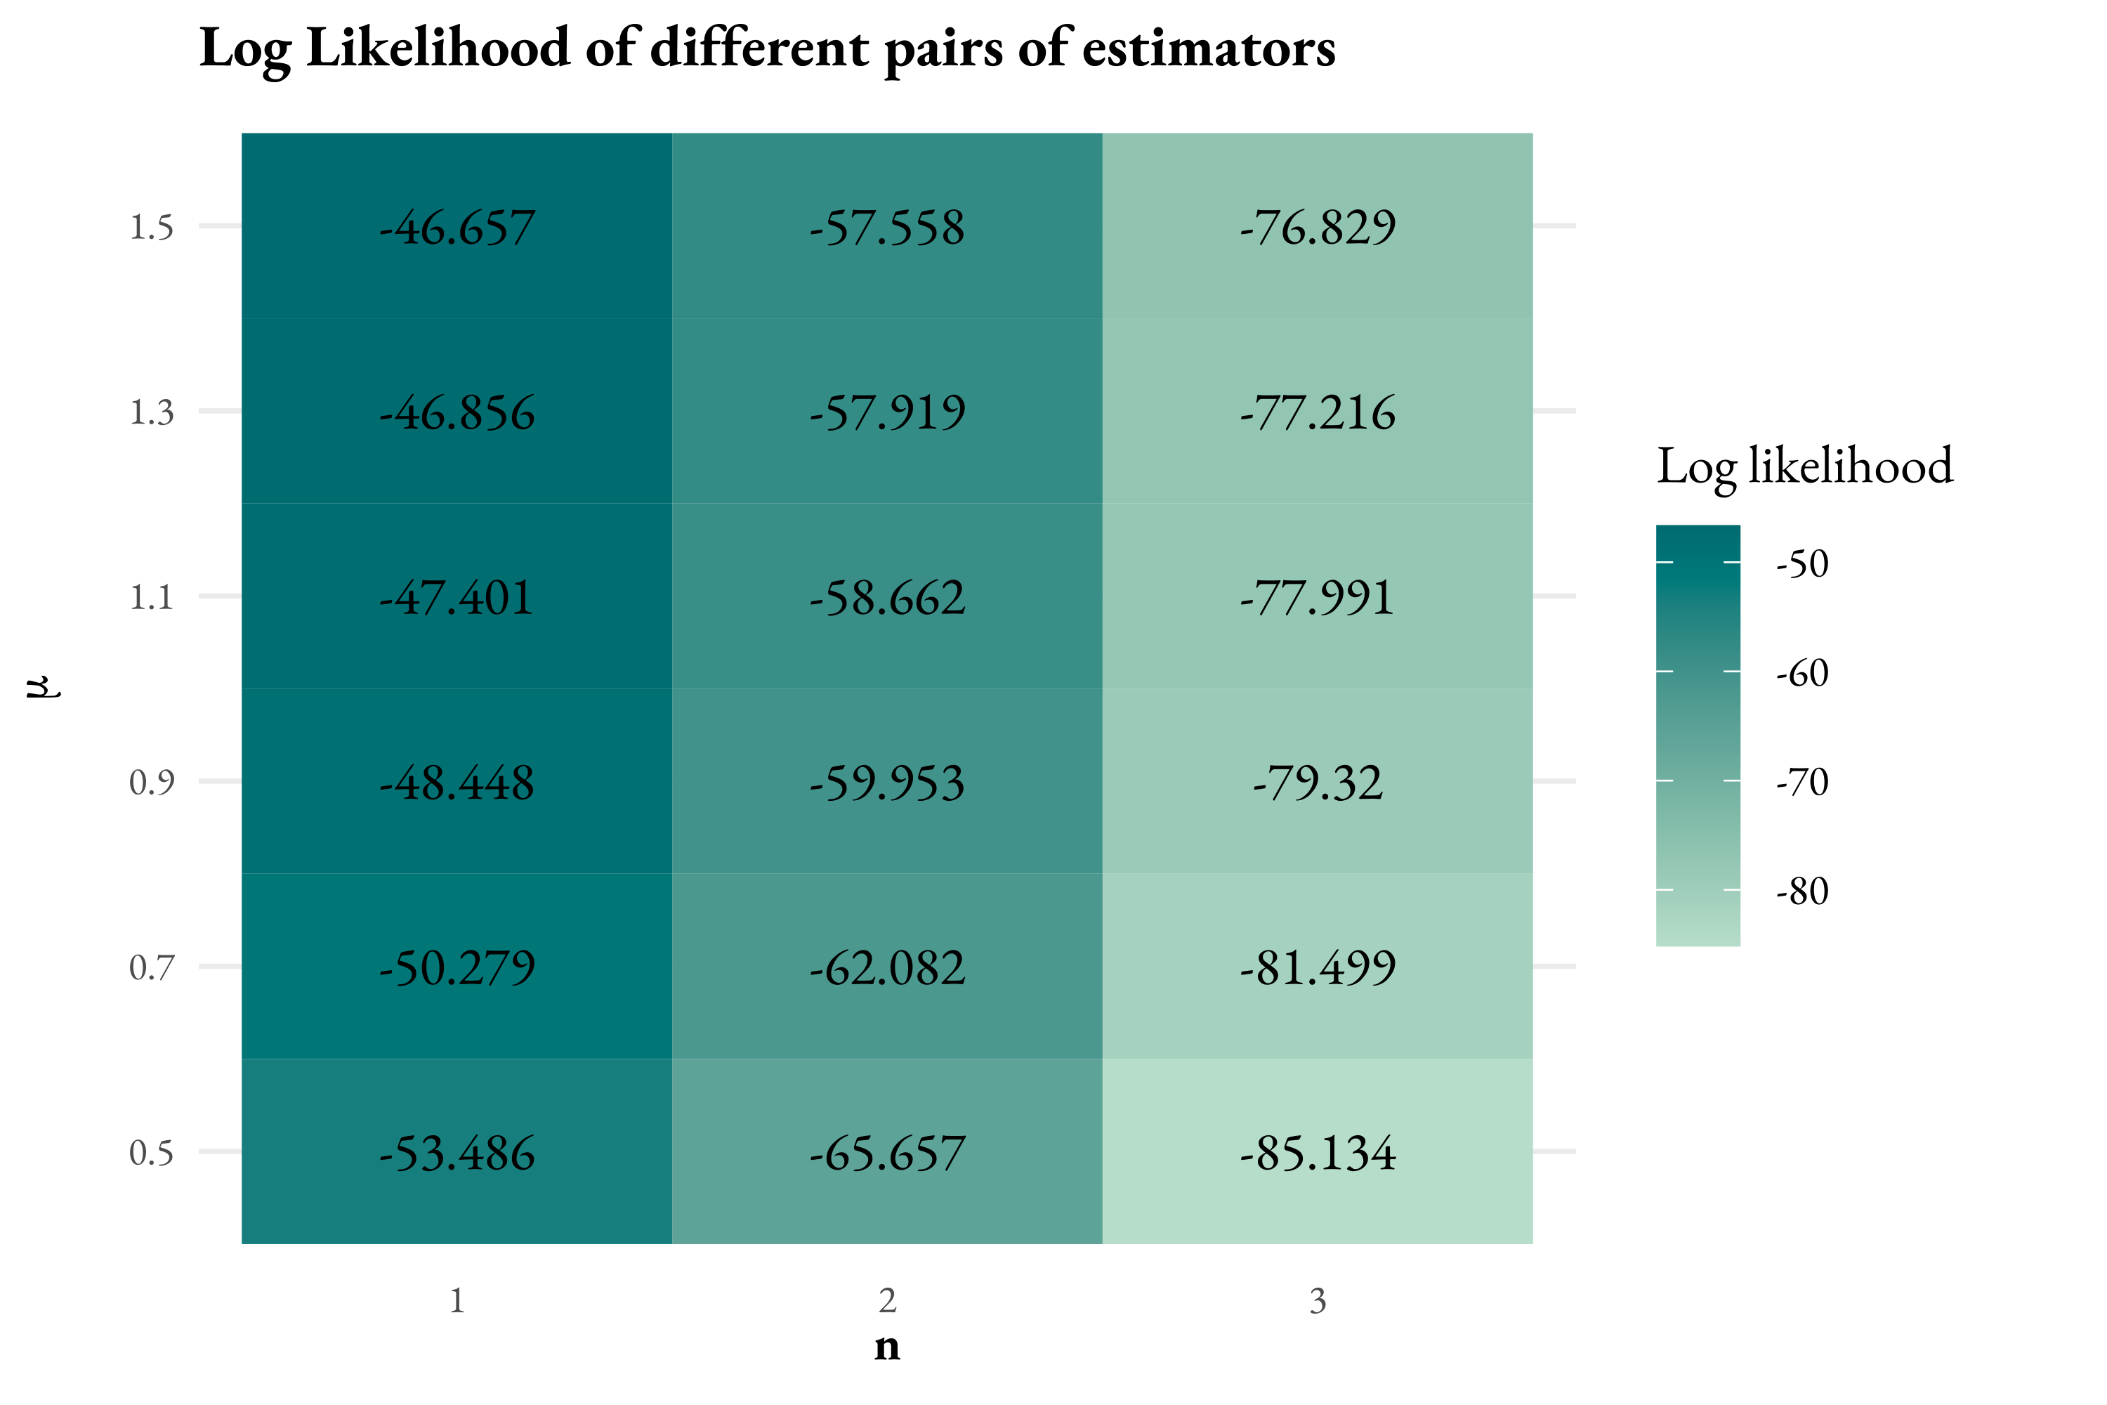
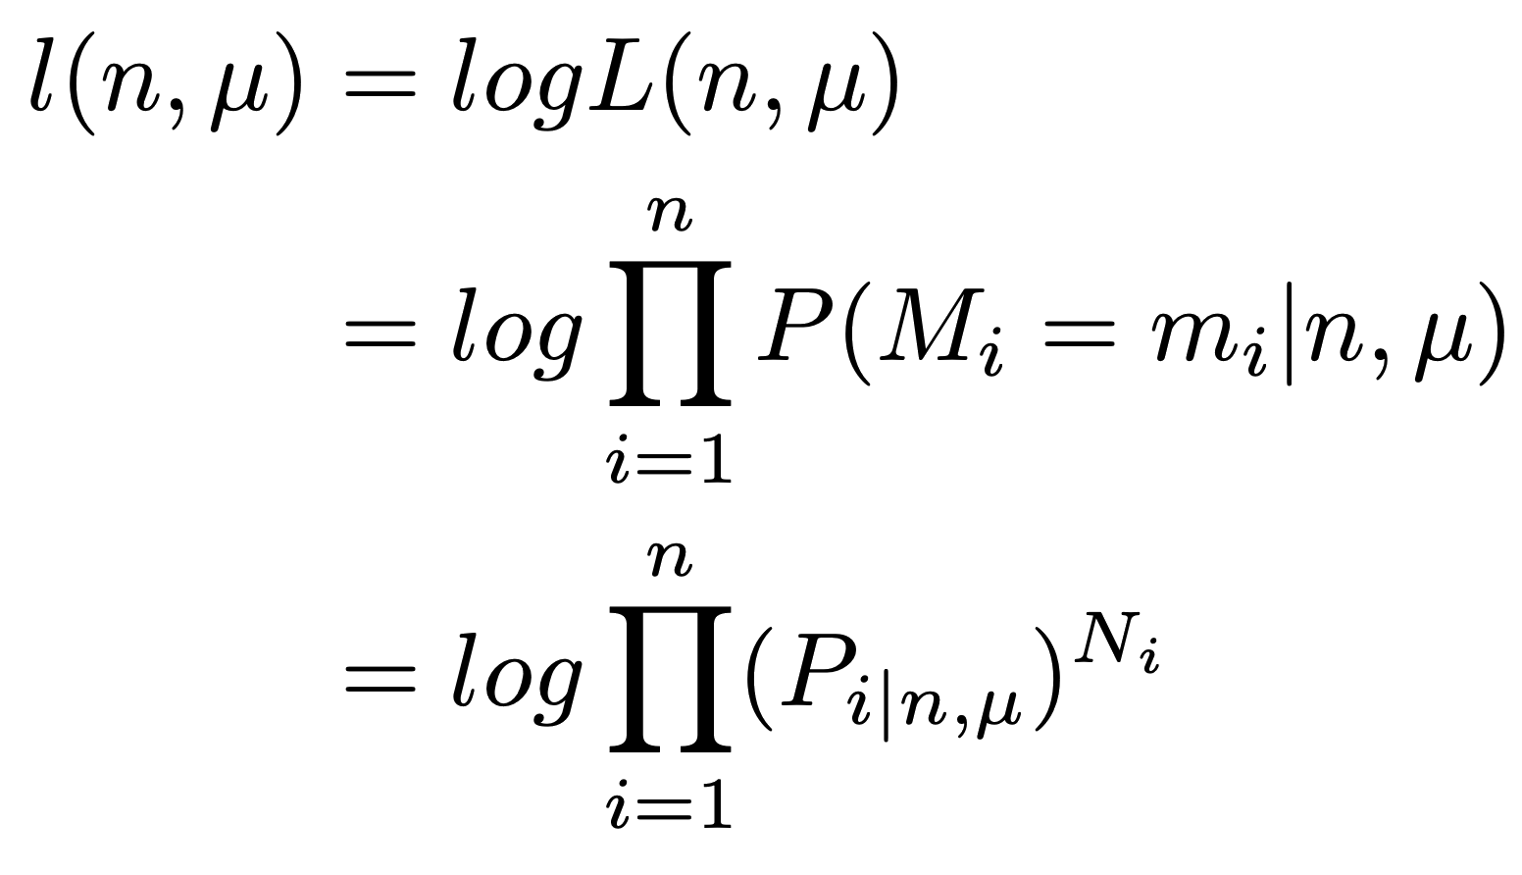
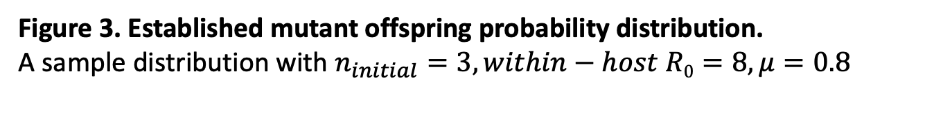
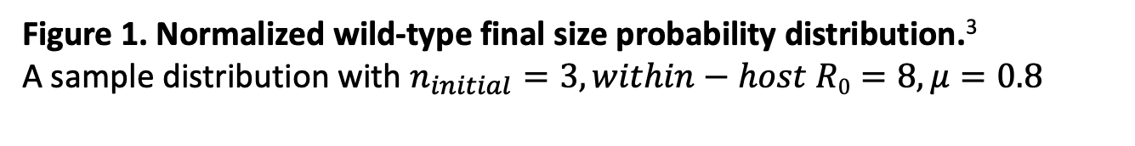
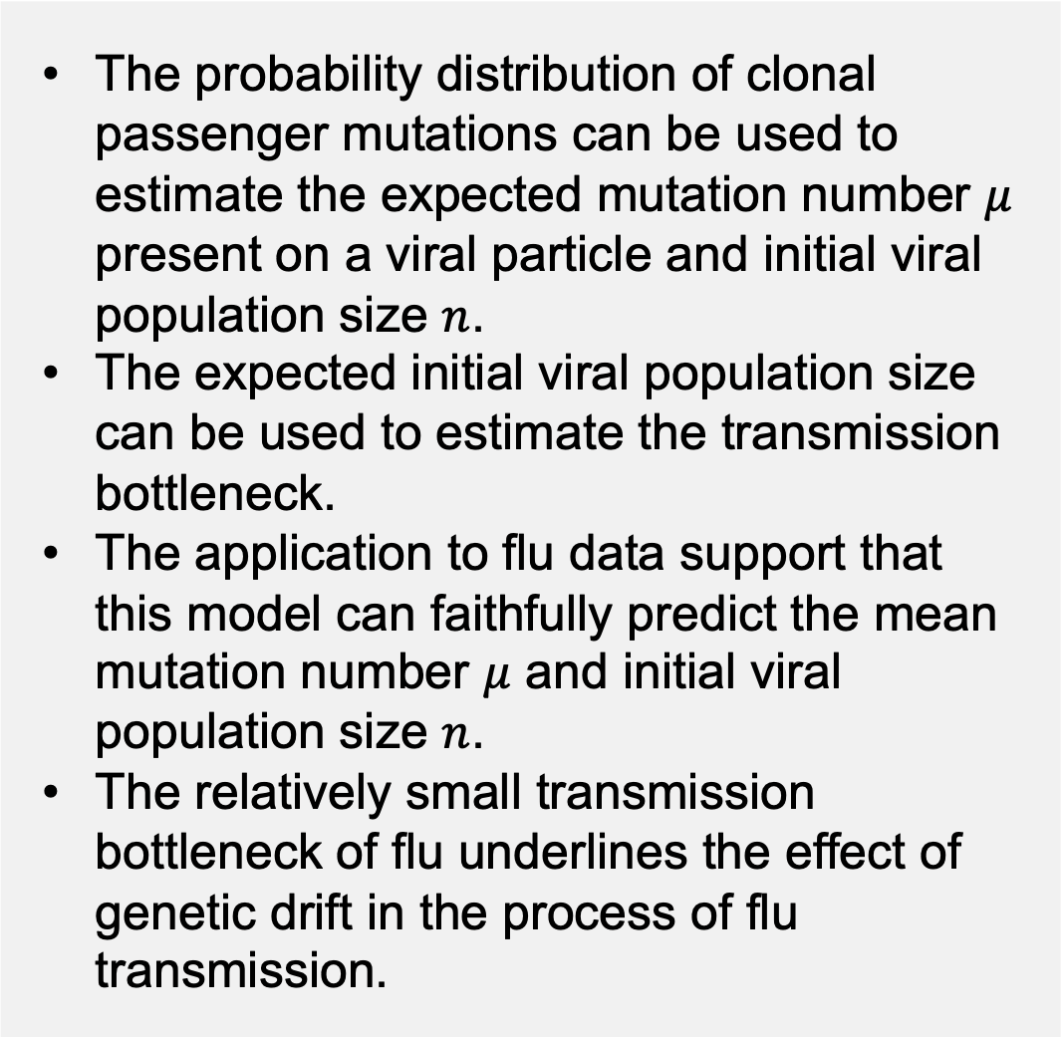

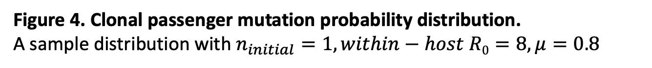
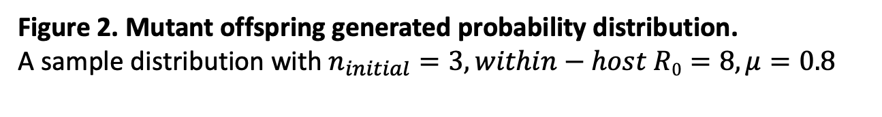
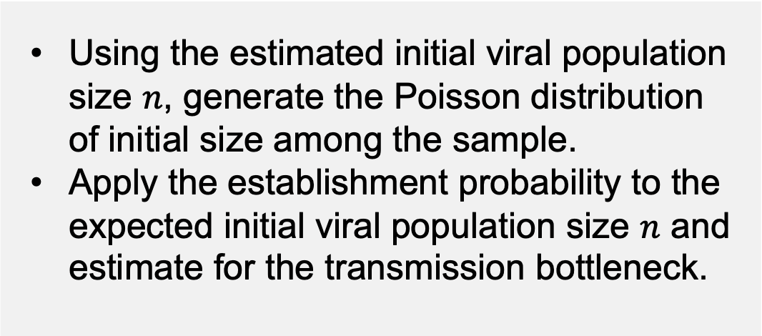
Virus Transmission Bottleneck Size Estimation
Using Patterns of Clonal Passenger Mutations
Teresa Shi¹, Katia Koelle¹
¹Department of Biology, Emory University, Atlanta, GA
Introduction
Results
Conclusions
Transmission bottleneck is defined as the number of viral particles transmitted from one host to establish an infection in another.¹
Accurate determination of the size of the bottleneck is important, especially for fast-mutating viruses like influenza, since narrow bottlenecks restrict the transfer of viral genetic diversity, potentially leading to a lower rate of viral adaptation.²
Estimating clonal passenger mutations can reveal important insights into viral transmission dynamics.
Here, we present a method for estimating transmission bottleneck sizes based on patterns of clonal passenger mutations observed in transmission pairs.
Question to be addressed:
What is the probability distribution of the number of clonal passenger mutations observed in a viral population? We will use this expression to calculate the viral transmission bottleneck size from empirical data
The probability distribution of clonal passenger mutations can be used to estimate the expected mutation number $μ$ present on a viral particle and initial viral population size $n$.
The expected initial viral population size can be used to estimate the transmission bottleneck.
The application to flu data support that this model can faithfully predict the mean mutation number $μ$ and initial viral population size $n$.
The relatively small transmission bottleneck of flu underlines the effect of genetic drift in the process of flu transmission.
Figure 1. Normalized wild-type final size probability distribution.³
A sample distribution with $n_{initial}=3,within−host R0=8,μ=0.8$
Figure 2. Mutant offspring generated probability distribution.
A sample distribution with $n_{initial}=3,within−host R0=8,μ=0.8$
Approaches
Future Directions
We model the possible mutations generated by a single viral particle using Poisson distribution with mean $μ$.
$P\left(mutation=k\right)=\frac{μ^{k}e^{−μ}}{k!}$
We model the offspring distribution of viral particles using a negative binomial distribution.
Using the estimated initial viral population size $n$, generate the Poisson distribution of initial size among the sample.
Apply the establishment probability to the expected initial viral population size $n$ and estimate for the transmission bottleneck.
X
…
X
X
Wild-type
Mutant 1
Mutant 2
X
Acknowledgements
Thanks to Dr. Koelle for unwavering support and guidance throughout the project.
Thanks to Nancy Chen, my generous roommate, for providing me with possible ideas for the development of methods.
Thanks to Kurumi and Mochi, two little kitten giving me emotional support whenever I needed.
Figure 3. Established mutant offspring probability distribution.
A sample distribution with $n_{initial}=3,within−host R0=8,μ=0.8$
Figure 4. Clonal passenger mutation probability distribution.
A sample distribution with $n_{initial}=1,within−host R0=8,μ=0.8$
References
Ghafari, M., C. K. Lumby, D. B. Weissman, and C. J. R. Illingworth, 2020 Inferring Transmission Bottleneck Size from Viral Sequence Data Using a Novel Haplotype Reconstruction Method. Journal of Virology 94: 17.
Leonard, A. S., D. B. Weissman, B. Greenbaum, E. Ghedin, and K. Koelle, 2017 Transmission Bottleneck Size Estimation from Pathogen Deep-Sequencing Data, with an Application to Human Influenza A Virus. Journal of Virology 91: 19.
Nishiura, H., P. Yan, C. K. Sleeman, and C. J. Mode, 2012 Estimating the transmission potential of supercritical processes based on the final size distribution of minor outbreaks. Journal of Theoretical Biology 294: 48–55.
Baccam, P., C. Beauchemin, C. A. Macken, F. G. Hayden, and A. S. Perelson, 2006 Kinetics of Influenza A Virus Infection in Humans. Journal of Virology 80: 7590–7599.
Offspring distribution
wild-type
establish
wild-type
extinct
Wild-type final size distribution
P_{x}
P₁₊
P₀
Mutant offspring generated
S₀
Mutant offspring established
S∞
S₁
Figure 5. Clonal mutation probability distribution from a sample flu data.
Figure 6. Log-likelihood heat map to estimate the expected mutation rate and initial population size.
We use the maximum likelihood estimation (MLE) method to plot the log likelihood heat map for a sample of flu data with known within-host R₀ = 11.1.⁴
S₂
Clonal mutation distribution
S₃

